Slide 2
Communication expectations
Everyday communication
Connecting with friends and family, small talk, going shopping, using public transport, eating out (Layer 1)
Education, employment, health, housing, drug and alcohol, justice, mental health, counselling services, child protection (Layer 2)
Vocabulary used in ‘specific setting’ (Layer 3)
Specific setting
Vocabulary
Notes:
The finally chosen 3 colours need to be replicated across subsequent slides.
Layer 1 = Everyday Communication (large circle)
Layer 2 = Specific setting (middle circle)
Layer 3 = Vocabulary (smallest circle)
Text on right matches each layer - may need reformatting to make this obvious

Slide 3
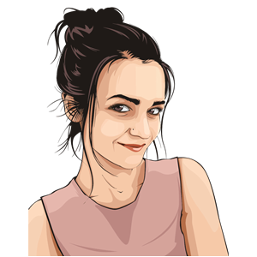
Everyday communication
Specific setting
Vocabulary
How does Gemma manage everyday situations?
Read her story and complete the activity
Everyday setting
Notes:
This slide discusses the Layer 1.
The current images may be copyrighted.
Ideally we need a picture of an ~ 20 year old women who speaks English only.

Slide 4
Communication skills needed for everyday situations
Adapt to people of different ages
Everyday communication
Specific setting
Assert oneself,
seek help
Keep up with conversation & contribute
Vocabulary
Manage sarcasm, language expressions & teen talk
Read and write well
Manage directions & explanations
Notes:
The colours for the ‘clock’ need to match the Layer 1 colour of the 3 circle graphic
Starting at 12 o’clock and working clockwise can text be altered to read
- Speak clearly in sentences
- Start & end conversations
Describe & explain in detail
Give clear directions, follow directions
Read & write well
Assert oneself; Seek help

Slide 5
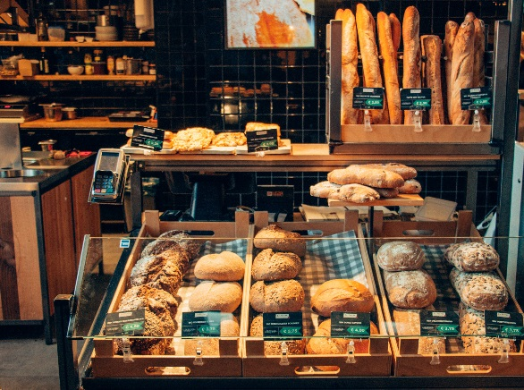
Communication skills needed for specific settings
Everyday communication
Specific setting
Vocabulary

Slide 6
Communication skills needed for TAFE
Everyday communication
New routines, diverse students
Specific setting
Classes: listen, read, write, contribute, ask questions
Seek learning support
Vocabulary
Express ideas, negotiate, resolve conflicts
Do assignments; read, research, plan, write
Group activities: role play, contribute, assert self
Notes:
Colour scheme to reflect Layer 2 colour
If new pictures are sought in slide 5, then TAFE picture needs adapting here.

Slide 7
Vocabulary at Gemma’s TAFE course
Everyday communication
Specific setting
Vocabulary
????
What are the policies we need to consider?
Use the Learning Framework to show….
How must we comply with the
regulatory requirements in an aged care facility?
How can we provide a duty of care to the elderly?
Show how we facilitate a sense of cultural safety to the aged care residents
Discuss how we can work collaboratively to monitor …….
Notes:
Colour scheme to reflect layer 3 (including heading)
If TAFE & female image have been altered, then need to update here.

Slide 8
Communication skills needed for the bakery job
Everyday communication
Speak loudly and clearly
Specific setting
Assert self, sort out dilemmas
Converse socially
Vocabulary
Read, learn, ask for help
Listen, remember, clarify
Explain, recommend, compare
Notes:
Layer 2 colour scheme

Slide 9
Vocabulary at the bakery
Everyday communication
Specific setting
Vocabulary
????
Ciabatta, Vienna, cob loaf, sourdough...
They’re changing the penalty rates for Sunday workers
We need to upsell more often to increase our profits
We can provide discounts to the customers who are on our loyalty program
Make sure you sanitise your hands and use your PPE before every shift
We need to promote our combo deals to reach our daily targets…….
Notes:
Use consistent colour scheme to reflect Layer 3
Update bakery picture & female to be consistent across slides

Slide 10
Communication skills needed to prepare and apply for a job
Everyday communication
Computer & research skills
Specific setting
Vocabulary
Presentation skills
Critically think & compare
Explain, describe & summarise
Read & write at a high level
Listen & clarify
Notes:
Layer 2 colour scheme

Slide 11
Vocabulary in job applications
Everyday communication
Specific setting
Vocabulary
????
We will need three referees
Do you prefer to work autonomously or collaboratively?
What qualifications have you listed on your resume?
How do you
practice and promote self-care?
How well do you think you meet the key selection criteria?
What are the values and principles you think are needed to work in aged care?
Notes:
Layer 3 colour scheme
Check images are consistent

Slide 12
What helps Gemma?
Being communication
Aware
Recognise her communication needs
Tune in and support her kindly
Being willing to
Adjust
Talk less, take time and explain words
Use a range of ways to communicate
Being able to
Accept
Support
Able to speak up when confused or unsure
Able to accept help from others
Being able to
Accommodate
to her learning style
Work out what helps and hinders
Being able to self advocate
Notes:
Aware: Gemma was fortunate to have her mum and sister recognize her communication needs
They were able to tune in and see things from her perspective
They realised when she was struggling in a range of areas and this helped her learn to ask for help as well
Adjust
It helped Gemma when other people reduced the amount that they talked and when they didn’t talk as fast.
It also helped when there was time to think, time to question and time to go over what she didn’t understand
This conveyed patience and reduced her anxiety
It helped Gemma when people used simpler words or explained them
Being able to show her things, use diagrams, pictures, and photos was also helpful
Accept
One of Gemma’s strengths was her ability to say when she didn’t understand something.
This was critical as then others knew to adapt the way they talk and to explain things in a way she could understand
Gemma was then able to let others outside her family, such as at TAFE staff, know she was struggling.
Because she could speak up, she was then able to accept help..
Accommodate
Gemma was able to explore a range of other ways to support her own learning, such as
Asking people to slow down
Repeating the orders at the bakery
jotting things down
Questioning specific words
Hands on learning worked best for her
Practising and repeating things
Video recording herself and watching it
She knew to find someone as a ‘go to’ person
Gemma was learning to advocate for herself and this helped her to become more confident overall

