Slide 1
Standard delivery – therapy session
Part A: What actually happened

Slide 2
Thoughts
“I can’t believe this.”
“My life is over.”
“I can’t cope” “I can’t believe I got a C.”
“I needed an A.”
“Everyone will think I’m stupid.”
“I won’t get into uni.”
“I can’t have the life I want. It’s not worth living.”

Slide 3
Thoughts
“I can’t believe this.”
“My life is over.”
“I can’t cope” “I can’t believe I got a C.”
“I needed an A.”
“Everyone will think I’m stupid.”
“I won’t get into uni.”
“I can’t have the life I want. It’s not worth living.”
Upset
Disappointed
Frustrated
Overwhelmed
Hopeless
Feelings

Slide 4
Thoughts
“I can’t believe this.”
“My life is over.”
“I can’t cope” “I can’t believe I got a C.”
“I needed an A.”
“Everyone will think I’m stupid.”
“I won’t get into uni.”
“I can’t have the life I want. It’s not worth living.”
Upset
Disappointed
Frustrated
Overwhelmed
Hopeless
Feelings
Behaviour/Actions
Leave the classroom
Say “Life isn’t worth living.”

Slide 5
Standard delivery – therapy session
Part B: What you could try next time

Slide 6
Thoughts
“I can cope.”
“This is crap but not the end of the world.”
“I will work harder from now on.”
“I can ask the teacher for feedback.”
“Nobody’s perfect.”
“It’s not ideal but it’s okay.”

Slide 7
Thoughts
“I can cope.”
“This is crap but not the end of the world.”
“I will work harder from now on.”
“I can ask the teacher for feedback.”
“Nobody’s perfect.”
“It’s not ideal but it’s okay.”
Hopeful
Determined
Calm/relaxed
Motivated
Feelings

Slide 8
Thoughts
“I can cope.”
“This is crap but not the end of the world.”
“I will work harder from now on.”
“I can ask the teacher for feedback.”
“Nobody’s perfect.”
“It’s not ideal but it’s okay.”
Hopeful
Determined
Calm/relaxed
Motivated
Feelings
Behaviour/Actions
Do something to distract self
Start studying for other tests
Ask the teacher for feedback
Use coping strategies

Slide 9
Alternative delivery – therapy session
Part A: What actually happened

Slide 10
Got a C.
Wanted an A.
Felt...(use chart)
upset
Told teacher "Life isn't worth living," and left classroom
Teachers felt...(use chart) worried
Teachers asked "How can we help?"
Amy: "I don't know."
Teachers send Amy home

Slide 11
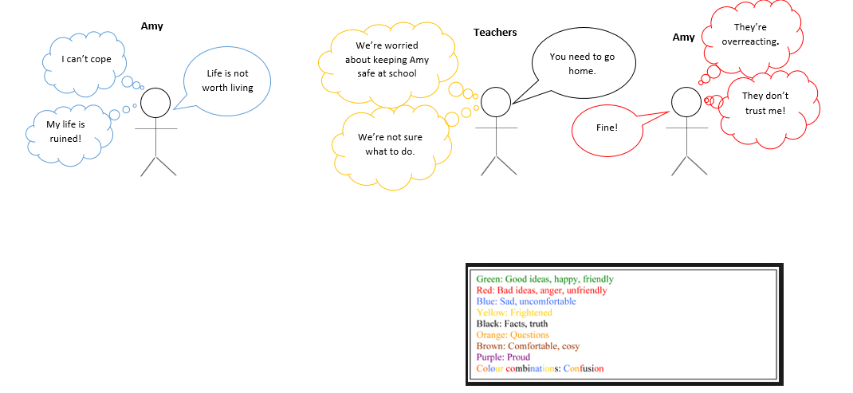
Got a C.
Wanted an A.
Felt...(use chart)
upset
Told teacher "Life isn't worth living," and left classroom
Teachers felt...(use chart) worried
Teachers asked "How can we help?"
Amy: "I don't know."
Teachers send Amy home

Slide 12
Alternative delivery – therapy session
Part B1: What you could try next time (option 1)

Slide 13
Got a C.
Wanted an A.
Felt upset
Told teacher "Life isn't worth living," and left classroom
Teachers felt worried
Teachers: "How can we help?"
Amy: "Give me space for 10 minutes then check on me," or "check my safety plan."
Teachers give Amy space/check safety plan
Amy able to say at school

Slide 14
Got a C.
Wanted an A.
Felt upset
Told teacher "Life isn't worth living," and left classroom
Teachers felt worried
Teachers: "How can we help?"
Amy: "Give me space for 10 minutes then check on me," or "check my safety plan."
Teachers give Amy space/check safety plan
Amy able to say at school

Slide 15
Alternative delivery – therapy session
Part B2: What you could try next time (Option 2)

Slide 16
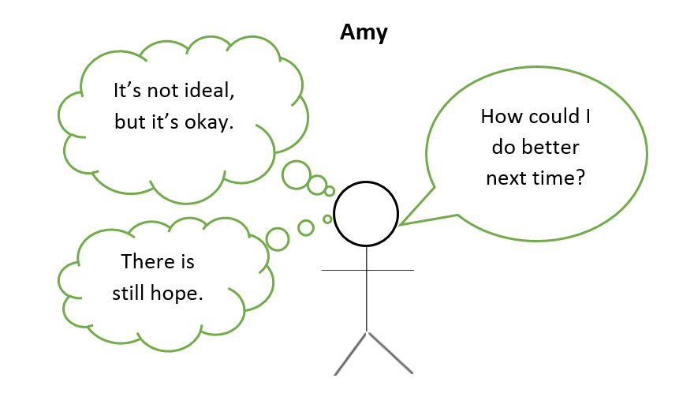
Got a C.
Wanted an A.
Felt upset but okay
Did something distracting
or
Asked for feedback
or
Started studying for next test
Stayed at school

